Slide 1

Self –Care and the Practitioner
“It’s not selfish to love yourself, take care of yourself, and to make your happiness a priority. It’s necessary.”
Mandy Hale

Slide 2

Why Self-Care?

Slide 3

"Care providers are unique people. We have the gift of being able to connect with others in ways that are difficult to explain and even more difficult for others to understand. Our unique ability to join with our clients that allows us a near first-hand experience of their inner world is perhaps our greatest gift; it is also our greatest challenge."
-Karl LaRowe, The Caregiving Personality

Slide 4
Burnout, Compassion Fatigue and Vicarious Trauma are unintended consequences of being a helper.
Notes:
Burnout, Compassion Fatigue and Vicarious Trauma are unintended consequences of being a helper.

Slide 5
Compassion Fatigue
Compassion Stress - a natural outcome of knowing about trauma experienced by a client, friend, or family member
Compassion Fatigue - "a state of exhaustion and dysfunction biologically, psychologically, and emotionally, as a result of prolonged exposure to compassion stress“
(Charles Figley, 1995)
Notes:
Compassion Stress - a natural outcome of knowing about trauma experienced by a client, friend, or family member
Compassion Fatigue - "a state of exhaustion and dysfunction biologically, psychologically, and emotionally, as a result of prolonged exposure to compassion stress" (Charles Figley, 1995)

Slide 6
Compassion Fatigue Symptoms
Lombardo & Eyre (2011)
Work
Emotional
Physical
  work dread or avoidance
  lower empathy
  absenteeism
  lack of joy
  irritability
  anxiety
  oversensitive
  restless
  resentment
  poor judgement and concentration
  headaches
  gastro issues
  muscle tension
  insomnia
  fatigue
  cardiac issues

Slide 7
Vicarious Trauma
When the victim/survivor trauma begins to affect the helper in such a way as to create distress
Symptoms: hyperarousal, intrusive thoughts, recurring dreams, avoidance, emotional "numbing", anxiety, depression
Notes:
When the trauma experienced by the victim/survivor begins to affect the helper in such a way as to create distress
Symptoms: hyperarousal (heightened reactivity), intrusive thoughts, recurring dreams, avoidance, emotional "numbing", anxiety, depression

Slide 8

3 Signs Of Vicarious Traumatization That You Are Aware Of In Yourself.
Notes:
Give basic directions for the whole exercise at the beginning.
Ask participants, to write down on one side of a piece of paper, 3 signs of VT they are aware of in themselves.
Alternating back and forth, trainers read 1 of the VT list first.

Slide 9
Vicarious Traumatization:
How This Work Will Change You
VT - a result of empathically engaging with and feeling responsible for traumatized clients.
Hallmark of VT is disrupted sense of hope and meaning.
Laurie Pearlman, Ph.D., Kay Saakvitne, Ph.D.
Notes:
Vicarious traumatization is a term coined in 1990 by Laurie Pearlman.
At that time, it was very unusual to talk about the impact of trauma work on treaters. In many settings, it still is.
VT is a result of giving our hearts in our work. If we didn’t invest in our clients and risk our hearts, but instead protected ourselves, we probably wouldn’t have VT AND we wouldn’t be very effective.
VT is really about the cumulative impact on us as treaters over time.

Slide 10

How VT Changes Us
VT can impact:
  Our core sense of meaning and hope
  Our identity and worldview
  Our core beliefs about safety, trust, esteem, control, and intimacy
  Our own ability to manage feelings
  Our bodily feelings and experience
Notes:
Review the slide:
With survivors of trauma there are certain areas or domains that are impacted. Many of the exact same domains in treaters are impacted by VT.
A core feature of VT is it’s impact on our basic sense of hope and our belief that our work and life has meaning. For some, this means cynicism about the world and the future. For others, it means a disrupted sense of spirituality, break in their beliefs about God or a higher power.
If we believe that the relationship is the primary agent of change, there are 2 sides to that relationship, the treater and the client. Both must be healthy for deep healing to happen.
Just like on an airplane, if the oxygen mask falls, you put it on yourself first, BEFORE your child. We need to take care of ourselves and our organizations need to help us do so, in order to do work that is sustainable and has quality and integrity.
From an attachment perspective, we need stability and continuity in relationships with clients. If people are burning out and leaving the organization quickly, this can’t happen.
The single most important factor in the success or failure of trauma work is the attention paid to the needs of the treater.
Addressing VT Is An Ethical Imperative.
VT can impact:
Our core sense of meaning and hope
Our identity and worldview
Our core beliefs about safety, trust, esteem, control, and intimacy
Our own ability to manage feelings
Our bodily feelings and experience

Slide 11
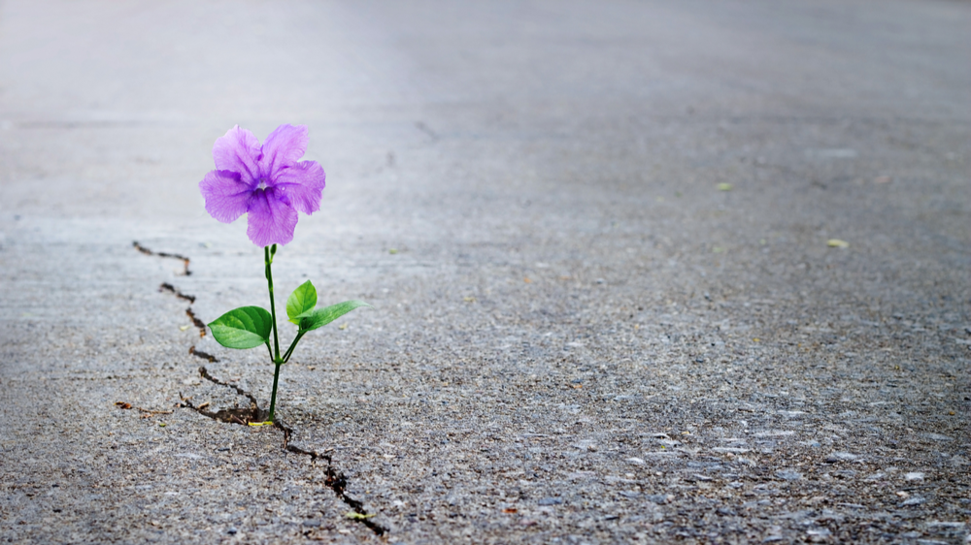
Vicarious Resilience
Our work does have a positive effect on us, and this effect can be strengthened by bringing conscious attention to it.
Notes:
Vicarious resilience happens when the professional experiences personal growth in their own life through witnessing the growth of their clients.
The main finding for trauma professionals is their work does have a positive effect on the therapists, and this effect can be strengthened by bringing conscious attention to it.
Vicarious Transformation
The positive growth and transformation of treaters as people, as a result of the work they do.
Pearlman, L.A. & Saakvitne, K. W (2012)
Compassion Satisfaction
“The pleasure you derive from being able to do your work well…to help others through your work…to contribute to the work setting or..the greater good of society.”
Stamm, B.H. (2009)

Slide 12
Vicarious Resilience: How?
Look
Look for the successes, no matter how small.
Focus on
Focus on the struggles that have been overcome in the past.
Identify
Identify strengths and potential.
Know
Know that anything is possible and healing really does happen.
Remember
Remember the greater purpose in what you do.
Incorporate
Incorporate success stories into everyday interactions .
Connect
Connect a specific example to the idea of vicarious resilience.
Notes:
Self-care should focus on resilience. Look for the successes, no matter how small.
Focus on the struggles that have been overcome in the past.
Identify strengths and potential.
Know that anything is possible and healing really does happen.
Remind yourself of the greater purpose in what you are doing.
Incorporate success stories into everyday interactions with colleagues and staff. This is an effective way to reinforce this as a concept.
Connecting a tangible, specific example to the concept of vicarious resilience helps reinforce the power of what could otherwise be abstract.
If we are asking our clients to get out bed each morning in the face of their challenges, we realize we need to be, and are, able to do the same. They get better, we get better.

Slide 13
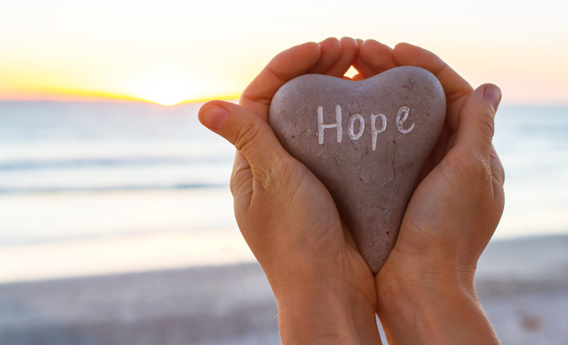
Holding onto Hope: Exercise:
3 ways in which you are positively impacted by the work you do - What benefits?
Notes:
What are 3 ways in which you are positively impacted by the work you do – benefits?
Share 1 benefits/rewards. Discuss again after reading this list.
How did it feel to hear the list of benefits versus the one we shared earlier?

Slide 14
Anticipating VT and Build In Protection
Awareness
  Be attuned to one’s needs, limits, emotions, resources.
  Heed all sources of information—thoughts, feelings, bodily signs, intuition.
  Practice mindfulness and acceptance.
Balance
  Among work, play, and rest
Connection
  To oneself, to others, and to something larger
Notes:
Awareness. Where in their body do they experience the stress of the job.
What physical signs would they first notice?
What emotional reactions would be a clue that they need a break?
Mention that we may get feedback from others before we even notice ourselves that we are being affected by the work. It is important to be open to that feedback.
Balance is important and difficult to achieve because the demands of the work are infinite. There is always something more we can do and it would probably help. We have to set limits and support each other in doing so. The best way to do this is to have things outside of work that are important to us such as relationships and activities that matter so that we will not be sucked up by the work.
Connection can be to oneself - noticing what you are feeling and needing; to other people via the relationships in our lives; to something larger such as a higher power, a political movement, nature, volunteering in your community.

Slide 15

Addressing VT:
Value of Self Care
“We do not learn from experience; we learn from reflecting on experience.”
~ John Dewey

Slide 16
Defining Self-Care
There is agreement that self-care is important and that we should prioritize it.
In general, self-care is an essential practice to nurture and care for our physical and psychological wellness, and behavioral health care providers should assess their personal tools for wellness.
Notes:
Self-care is an important part of ensuring well-being for people who are providing recovery supports and other behavioral health services. One recent study showed that over half of behavioral health care providers reported experiencing symptoms of burnout.1 Further research shows that employees who do not attend to—or who are less comfortable discussing—their mental health are also “more likely to report feeling burnout and their mental health suffering because of work.”2 Self-care practices should be individualized and culturally informed. Both individuals and organizations have a role to play in promoting self-care and overall well-being.

Slide 17
6 Benefits Of Self Care
Better productivity.
Improved resistance to disease.
Better physical health.
Enhanced self-esteem.
Increased self-knowledge.
More to give.
Notes:
Better productivity. When you learn how to say “no” to things that over-extend you and start making time for things that matter more, you slow life down in a wonderful way. This brings your goals into sharper focus and helps you to concentrate on what you’re doing.
Improved resistance to disease. There is evidence that most self-care activities help your body go into a restful, rejuvenating mode, helping it to fortify its immune system.
Better physical health. Less stress and a better immune system can surely help you feel more physically able and strong inside and out.
Enhanced self-esteem. You treat yourself like you matter and have intrinsic value. This can go a long way toward discouraging negative self-talk and your critical inner voice.
Increased self-knowledge. The exercise of figuring out what makes you feel passionate and inspired can help you understand yourself a lot better. Sometimes, this can even spark a change.
More to give. When you’re good to yourself, you might think you’re being selfish. In truth, self-care gives you the resources you need to be compassionate to others as well. Giving compassion is a bit like filling a bucket; you can’t fill someone else’s if you don’t have enough of your own!

Slide 18
What Self-Care Isn’t
Being selfish
Actions that deplete us
Adding more tasks to you to do list
An emergency burn-out prevention plan
A New Year’s resolution
A quick fix

Slide 19
Signs You Need To Focus On Self-Care
Increased anxiety
Decreased patience
Difficulty relaxing
Changes in memory and focus
Feeling more irritable/cynical
Human being vs. human doing
Experiencing less fulfillment at work

Slide 20

What Are The Consequences Of Not Taking Care Of Oneself?
Compassion fatigue
More sick days
Less productivity
Career burn out
Less enjoyment of job
Notes:
Mental health professionals are especially vulnerable to these consequences.

Slide 21
What Type Of Self Care Activities Do You Currently Use?
Discussion
Notes:
Let me start off by first asking you this simple question: “Do you take care of yourself?” I would bet that most of us will instinctively answer “Yes, of course I do.”
Now, if I ask you a more specific question, such as “How do you take care of yourself?” – well, the response may get a bit more complicated.
In essence, this is what self-care is: caring for ourselves, ya’ll. It is really anything that we deliberately do (or refrain from doing) with our own well-being in mind. It means giving ourselves the same grace, compassion, and care that we give to others.

Slide 22

Types Of Self Care
Sensory
Emotional
Spiritual
Physical
Social
Notes:
One of the main excuses people make for ignoring articles about self-care is that they just don’t have time. The great news is that there are many different self-care practices, and none of them are especially difficult or require a lot of planning. The trick is to find some that you genuinely enjoy and that fit with your life and values.
Here are the five main categories of self-care: SLIDE

Slide 23
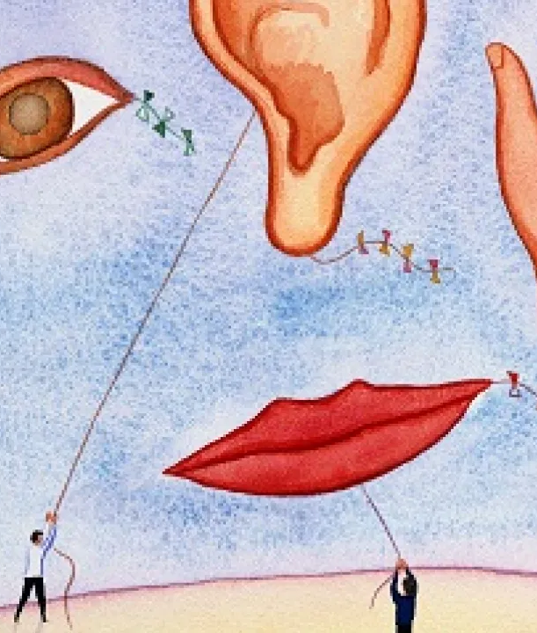
Sensory
Helps to calm your mind.
Easier to live in the present moment.
Consider all of your senses.
Ask yourself what sense do rely on most.
Notes:
Sensory self-care is all about helping to calm your mind.
When you can tune into the details of the sensations all around you, it’s easier to live in the present moment. And when you’re in the present, you can more effectively let go of resentments related to the past or anxieties about the future.
When you think about practicing sensory self-care, consider all your senses: touch, smell, sound, and sight.
Most people are more responsive to one than the others, so ask yourself what that sense might be for you.

Slide 24
Examples Of Sensory Self-care
Cuddling up under a soft blanket.
Going to the countryside and focusing on the smell of the air.
Watching the flames of a candle or a fire.
Feeling the water on your skin during a hot bath or shower.
Focusing on the movements of your own breathing.
Lying down and listening to music with your eyes closed.
Notes:
Others:
Having a small square of the most delicious chocolate.
Walking barefoot in the grass.
Having a massage.
Holding a pet.

Slide 25

Emotional
Make sure you fully engage with your emotions.
It’s healthy to feel them, accept them, and move on.
Remember, you are not blameworthy for the emotions you feel; only how you behave in response to them.
Notes:
When it comes to your emotional health, one of the best self-care tips is to make sure you fully engage with your emotions. When you face them head-on, this actually helps with stress.
You may feel tempted to push down feelings like sadness or anger, but it’s healthy to feel them, accept them, and move on.
Remember that emotions are not “good” or “bad” in themselves. You are not blameworthy for the emotions you feel; only how you behave in response to them.

Slide 26
Emotional Self-Care Ideas
Keep a daily journal and be honest about your feelings.
Write a list of “feeling words” to expand your emotional vocabulary.
Make time to be with someone who truly understands you.
Let yourself cry when you need to.
Deliberately encourage yourself to laugh with old memories or funny videos.
Practice Emotional Intelligence.
Notes:
See a therapist, (EAP) for allotted sessions of general personal development.

Slide 27

Spiritual
Applicable regardless of ‘religious’ beliefs.
Is about getting in touch with your values and what really matters to you.
Developing a sense of purpose is vital to your recovery.
Notes:
Spiritual self-care isn’t just about believing in a deity. It’s applicable to atheists and agonistics as much as to religious people.
Spiritual self-care is about getting in touch with your values and what really matters to you.
Self-care tips for depression often stress that developing a sense of purpose is vital to your recovery. Below are some versatile examples that can help you with this.

Slide 28
Spiritual Self-Care Ideas
Keep up a daily meditation or mindfulness practice.
Attend a service, whether it is religious or humanistic.
Walk in nature and reflecting on the beauty around you.
Make a daily list of 5-10 things that make you feel grateful.
Be creative, whether through art, music, writing or something else entirely.
Say affirmations that ground your sense of self and purpose.
Notes:
Make a list of 5-10 things that make you feel alive, then ask yourself how you can better incorporate these things into your life.
Go on a trip with the sole purpose of photographing things that inspire you.

Slide 29

Physical
Vital not only for your bodily well-being but also for helping you let off steam.
Broaden the concept of physical self-care
Notes:
The importance of self-care definitely extends to purely physical aspects of your health. Physical activity is vital not only for your bodily well-being but also for helping you let off steam.
You might think there’s nothing fun or self-compassionate about going to the gym, but that’s far too narrow a way of thinking about physical self-care. Instead, broaden the concept by thinking about the following lists

Slide 30
Physical Self-Care Ideas
Do yoga. Even if you’ve never tried it, there are poses that are perfect for beginners.
Go for a walk with your dog or through the neighborhood.
Say “no” to invitations when you’re simply too tired to enjoy them.
Don’t push yourself to do your exercise routine when you’re run down or unwell.
Commit to 7-9 hours of sleep per night, barring exceptional circumstances.

Slide 31

Social
Connecting with other people is necessary for happiness for a large diversity of people.
It helps you to understand that you’re not alone. This can help us combat loneliness and isolation.
Social self-care is about choosing to do things with people who really make you feel good.
Notes:
It might look different depending on whether you’re an introvert or extrovert. However, connecting with other people is necessary for happiness for a large diversity of people.
It helps you to understand that you’re not alone. Plus, it can also give us a sense of being fully “seen” by others. This can, in particular, help us combat loneliness and isolation.
Social self-care isn’t about just doing things with others for the sake of it, but about choosing to do things with people who really make you feel good.

Slide 32
Social Self-Care Ideas
Make a date to have lunch or dinner with a great friend.
Consider joining a group of people who share your interests.
Stop socializing with those who undermine or disempower you.
Strike up a conversation with someone interesting.
Join a support group for people who struggle with the same things you do.

Slide 33
Additional Self-Care Tips
Recognize there is a limit to what you can do or take on.
Leave time for transition between work and home.
Explore and practice stress management techniques.
Do fun activities that take you completely away from your work and life stress.
Remind yourself we can only do our best - and let go and trust the rest!
Share perspectives.
Notes:
Recognize there is a limit to what you can do or take on. By doing more, you risk your ability to serve your clients, your organization and most of all yourself!
Try not to take your work home. Leave time for transition between work and home. Transition is the perfect time for a self-care ritual.
Explore and practice stress management techniques, get regular exercise and do fun activities that take you completely away from your work and life stress.

Slide 34
Sustainable Self Care Begins With You!
Be kind to yourself.
Enhance your awareness with education and experiences.
Accept where you are always on your path.
Exchange information and feelings with people who can validate you.
Clarify your personal boundaries. What works for you; what doesn't.

Slide 35
Sustainable Self Care Begins With You!
Express your needs verbally.
Take positive action to change your environment.
Create a network of support.
Build your Self-Care Toolbox and use it every day!

Slide 36

How Do We Support Each Other?
“The more reflective you are, the more effective you are.”
~ Hall & Simeral
Notes:
Secondary traumatization (ST), Vicarious traumatization (VT) and Compassion fatigue (CF) can directly contribute to staff turnover. Turnover rates in behavioral health are at 40%.

Slide 37
Summary: What Can We Do?
Be kind to one another
Talk to peers about their feelings and acknowledge these feelings
Validate and respect co-workers
Establish support systems & promote informal socializing to reduce feelings of isolation
Offer breaks away from the clients
Address safety issues
Provide adequate resources
Notes:
Although nearly everyone who performs emotionally intense work can be susceptible to vicarious trauma and burnout-- and those who work with traumatized children are considered at high risk --certain professions in the nonprofit field may not have sufficient help in handling their rawest feelings. Think of it as an Occupational Hazard.
Not giving these workers help can undermine not only an organization but its long-term mission.

Slide 38
Summary: What Can We Do?
Create an environment that is reasonably comfortable
Monitor for signs of burnout
Look out for your own needs and encourage staff to do the same
Make responsibilities clear
Tell new or prospective employees what to expect and be blunt
Consider seeking outside help

Slide 39

Questions?

Slide 40
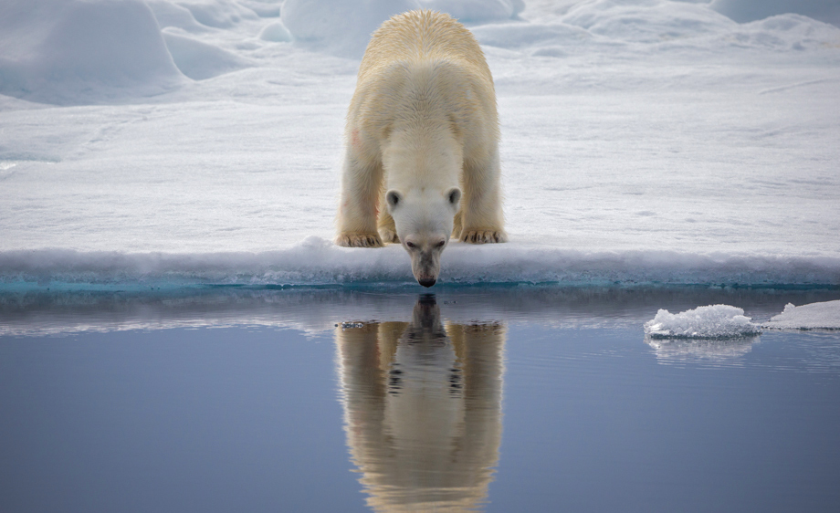
Thanks for your
Attention and Participation!
John
jamato@familylinks.org

