Slide 1
Competency to Stand Trial: A Mobile Competency Restoration Team and their Effort to Support Counties in Pennsylvania

Slide 2

LEARNING OBJECTIVES
Participants will have an improved understanding of the term “incompetent to stand trial” and the process of restoring one’s legal competency.
Participants will learn about what factors are considered when determining outpatient vs inpatient restoration.
Participants will learn about Merakey’s Mobile Competency Restoration Team (MCRT) and their efforts to restore and/or maintain competency on an outpatient basis.

Slide 3

PREVALENCE
MENTAL HEALTH STATISTICS
The Costs
1 in 5 (57.8 million) U.S. adults experience mental illness each year – 22.8%
1 in 20 (14.1 million) U.S. adults experience serious mental illness each year – 5.5%
1 in 6 (7.7 million)U.S. youth aged 6-17 experience a mental health disorder each year – 16.5%
50% of all lifetime mental illness begins by age 14, and 75% by age 24
33.5% (19.4 million) of U.S. adults with mental illness also experience a substance use disorder in 2021
47.2% of U.S. adults with mental illness (65.4% with SMI) received treatment in 2021
164 million people live in designated “Mental Health Professional Shortage Areas” (155 million in 2020)
At least 8.4 million people in the U.S. provide care to an adult with a mental or emotional health issue
Among people in the U.S. aged 18-44, psychosis spectrum and moos disorders account for nearly 600,000 hospitalizations each year
Mental illness and substance use disorders are involved in 1 out of every 8 emergency department visits by a U.S. adult (estimated 12 million visits)
Across the U.S. economy, serious mental illness causes $193.2 billion in lost earnings each year
NAMI. “Mental Health by the Numbers” April 2023, https://www.nami.org/mhstats

Slide 4
Mental Health and the Criminal Justice System
About 2 million times each year, people with SMI are booked into jails
About 2 in 5 people who are incarcerated have a history of mental illness (37% in state and federal prisons and 44% held in local jails)
Nearly one in four people shot and killed by police offers between 2015 and 2020 had a mental health condition.
Suicide is the leading cause of death for people held in jails.
An estimated 4,000 people with SMI are held in solitary confinement inside U.S. prisons
NAMI. “Mental Health by the Numbers” April 2023, https://www.nami.org/mhstats

Slide 5
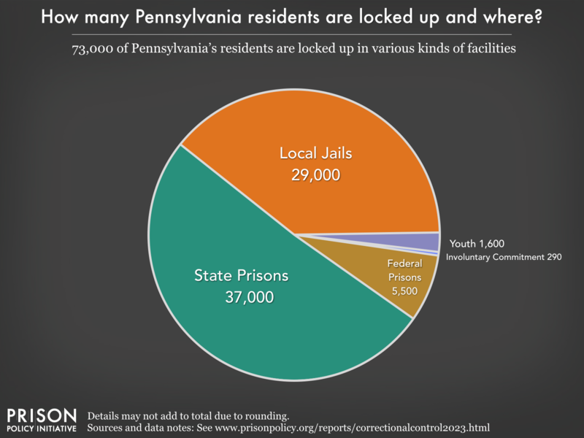
MENTAL HEALTH NEEDS IN THE JUSTICE SYSTEM
Research indicates that on average, Serious Mental Illness (SMI) (defined as significant impairment impacting daily functioning; disorders such as schizophrenia, schizoaffective disorder, bipolar disorder, major depression or brief psychotic disorder) occurs at the following rate:
SMI in the general public, 5.5%
SMI in prison averages, 15%
SMI in jail averages, 20%
NAMI. “Mental Illness” 2019, https://www.nimh.nih.gov/health/statistics/mental-illness Prison Policy Initiative. “Pennsylvania Profile” https://www.prisonpolicy.org/profiles/PA.html

Slide 6
Competency Versus Mental Health
Competency: refers to an individual’s legal ability to make decisions. It is a legal determination made by a court and is typically applied to individuals who are deemed unable to make decisions due to cognitive impairments, mental illness, or other conditions¹.
Key Points:
Competency is related to an individual’s capacity to participate in legal proceedings.
Competency assessments are crucial for patient safety and protection of providers from legal retribution².
Mental Health: encompasses an individual’s emotional, psychological, and social well-being. It affects how we think, feel, and act, and it plays a significant role in our daily lives.
Key Points:
Mental health conditions can range from mild to severe and may impact a person’s ability to function effectively.
Seeking professional help and support is essential for managing mental health challenges.
In summary, while competency focuses on legal decision-making abilities, mental health pertains to an individual’s overall psychological well-being. Both concepts are critical in understanding and addressing complex patient encounters.

Slide 7

COMPETENCY RESTORATION
Competency to stand trial is a legal term, not a psychological construct.
Constitutional Standard
Several legal milestones have resulted in the following rights:
1960
Dusky v. United States Defendant must have a factual and rational understanding of the proceedings and an ability to consult with their lawyer
1972
Jackson v. Indiana Defendant cannot be held longer than the reasonable period necessary to attain competency in the foreseeable future.
2003
Sell vs. United States
Involuntary medication is permitted for restoration if it is reasonably likely to aid in restoration and is the least intrusive treatment option.

Slide 8

COMPETENCY RESTORATION
At any point, competency may be questioned (by anyone involved in the proceedings). The Judge may then order a motion for an initial competency evaluation.
Estimates suggest 60,000 evaluations are requested each year for felony-charged defendants in the U.S, however currently the estimate suggests at least 130,000 competence evaluations are conducted in the U.S each year.
Kois, L. E. (2022). Updating the “Magic Number” - Contemporary competency to proceed metrics reported (and not reported) by U.S. judiciaries [Webinar]. University of New Mexico School of Medicine, Law, and Mental Health Lecture Series.

Slide 9
COMPETENCY RESTORATION
Constitutionally-Based; generally, the same across all jurisdictions
Function based; no diagnostic requirement, though some states have specific statutes which include mental disorder requirements
Based on an individual’s present ability to engage in their case (factual and rational understanding, the ability to participate in their own defense) not based on an individual’s mental status at the time the crime was committed.
Competency evaluations should be assessing an individual’s “triability” (can the individual meaningfully participate in their case?)
Not intended to address issues related to treatment
Communication with the evaluator is not confidential, but also nothing said during the examination may be used against an individual on any issue other than of their condition related to legal competence.
Wilson Center for Science and Justice. “Recap: Experts Discuss Mental Illness and Competency Restoration” July 2021, https://wcsj.law.duke.edu/2021/07/recap-experts-discuss-mental-illness-and-competency-restoration/
Wall BW, Ash P, Keram E, Pinals DA, Thompson CH. AAPL Practice Resource for the Forensic Psychiatric Evaluation of Competence to Stand Trial. J Am Acad Psychiatry Law. 2018 Sep;46(3):373. doi: 10.29158/JAAPL.003781-18. PMID: 30368470.

Slide 10
Brief Explanation on Competency
Max Wachtel Three Minute Explanation Competency To Stand Trial (youtube.com)

Slide 11
COMPETENCY RESTORATION
What does this all mean?
An individual’s understanding is assessed and may be evaluated formally
A Judge rules on competency (research suggests judges agree with the evaluator in 90% of cases)
An individual must receive treatment/education to restore their competency; to establish an understanding of the charges, the proceedings, behavioral expectations, role of court personnel, and to better assist their attorney. Only once restored, can an individual proceed with their case.
Collaboration and periodic re-evaluation to assess competency and likelihood of restorability within the foreseeable future
The reality is that…
Biggest constraints are TIME and RESOURCES
Historically, defendants would be treated in an inpatient hospital setting. Average cost per defendant is very high
With deinstitutionalization, there have been less and less beds available.
This can mean long waitlists (ACLU lawsuits), which violates 6th Amendment rights
While waiting for services, individuals may be demonstrating continued unsafe behaviors that compromise their own and others’ safety

Slide 12

MCRT ROLE OF MEMBERS
Mobile Competency Restoration Team
A team of professionals; Restoration Counselor (Bachelor/Master level), Forensic Peer Specialist, and Administrative Assistant, are led by a Program Director (Masters level, licensed)
This team covers a 10-county region
Mercer, Venango, Crawford, Lawrence, Butler, Washington, Westmoreland, Armstrong, Indiana, Beaver County
Services take place in an “outpatient”/community setting (jail, LTSR, EAC, local library, etc.)
COMPREHENSIVE & COLLABORATIVE
Team: Provides coordination services and psycho-legal education services that are designed to restore and/or maintain the individual’s competence to stand trial.
Restoration Counselor: Provides psychoeducation, addresses community and natural service and supports if appropriate
Forensic Peer Specialist: Provides psychoeducation, normalizes treatment, offers peer support, will assist in linking with other service providers (if applicable)
Administrative Assistant: Provides program organization
Program Director: Supervises team, program outreach, completes Fit-R screening tool

Slide 13


MCRT
What MCRT Is… What MCRT Is Not…
An Outpatient Competency Restoration Program (jail, LTSR, EAC, library, etc), with sessions 1-3x per week
Personalized Education of subjects related to the court process; designed for both individual and group instruction for learners who present with a variety of needs and preferences
Facilitation of Interagency Meetings to support the individual’s restoration
Ongoing engagement in educational curriculum (CompKit) to sustain legal competency and to uphold an individual’s Right to Due Process.
Expanding to meet the needs communicated by the counties
A replacement to existing forensic programs; simply an alternative option for consideration
One Size Fits All; every individual’s needs and circumstances are assessed, and adaptations are made at every step of the process
Providing Mental Health or Legal Services
Determining Competency; that remains the responsibility of the Court
Appropriate for all; communication of needs and barriers is ongoing with the Court

Slide 14

THREE PATHS TO SERVICE WITH MCRT
MCRT
Scenario One:
- Individual is deemed “Incompetent to Stand Trial” by a Judge
- Restoration services are needed to educate and support acquisition of competency skills
MCRT Maintenance
Scenario Two:
- Individual has been working with MCRT and is now deemed “Competent to Stand Trial” by a Judge
- To reduce “decompensation” of skills, ongoing education may be needed to promote maintenance of skills
MCRT Maintenance
MCRT SERVICES
Scenario Three:
- Individual recently completed a restoration program and is now deemed “Competent to Stand Trial” by a Judge
- To reduce “decompensation” of skills, ongoing education may be needed to promote maintenance of skills
-Initiation of services with MCRT
Decompensation: when an individual regresses back to “incompetent to stand trial” status which then directly impacts their case timeline and rights for due process.

Slide 15
MCRT GOALS… IN ORDER TO…
Provide Psychoeducation to aide in the restoration and/or maintenance of competency.
Provide supports to assist with ongoing competency during court proceedings and processes.
Work with the criminal justice system to provide the needed information and supports necessary to assist an individual in regaining and/or maintaining competency.
Provide discharge services to community supports when appropriate to reduce recidivism.
Assist the individual to function adequately in six areas and to have a Judge determine that the individual has regained and/or maintained competency to stand trial status to proceed with their case.
1) Understanding the nature of the charges
2) Have knowledge of possible pleas, consequences, and penalties
3) Have knowledge of court procedures
4) Have the capacity to demonstrate rational understanding
5) Have the capacity to assist their attorney
6) Have the capacity for appropriate behavior in the court

Slide 16

PA COMPKIT
PA Department of Human Services (DHS) Competency to Proceed Training Resources (CompKit) curriculum for all restoration services
Materials for instruction in a 1:1 and group setting
Instructional materials are provided in a variety of formats to reflect the different learning needs of different populations as well as differing cultural considerations, mental statuses, cognitive functioning, and educational achievement levels
Designed to teach Rational and Factual Understanding of the charges, court proceedings, role of court staff, pleas, and behavioral expectations
Also works to improve the individual’s interactions with their defense attorney

Slide 17
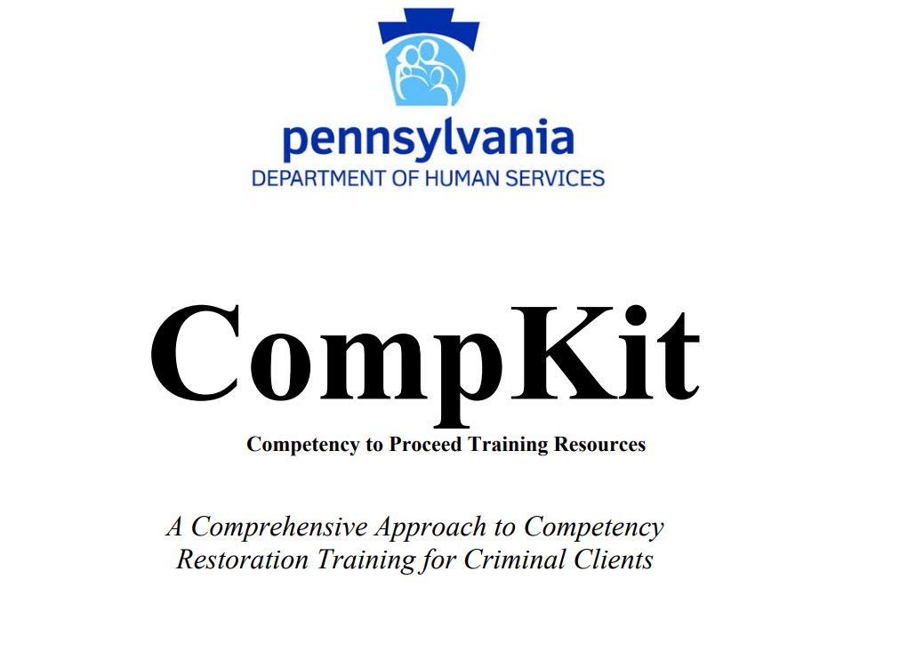
EXPANDED CURRICULUM
MCRT has spent the last 3 years expanding the curriculum offerings to engage every learner and to accommodate their needs and preferences in new and creative ways
Services are individualized and person-centered
MCRT has successfully worked with individuals with a range of diagnoses, including those organic in nature
Typically, will meet 2 times per week, or as needed, for a duration of at least 1 hour, unless otherwise indicated by facility, referral source, legal system
Individuals have been restored to competency quickly, efficiently, and while remaining in their local placement
Some courts and participants have seen the value of regular programming; ordering maintenance services to sustain skills gained while the case proceeds in the courtroom.

Slide 18
THE DETAILS: REFERRALS FOR THOSE “INCOMPETENT TO STAND TRIAL”
Step 1
Individual is deemed "Incompetent to Stand Trial" by a Judge
Step 2
Judge orders Competency Restoration Services
Step 3
County designee* completes the "Merakey MCRT Referral Form"
Step 4
Step 6
Step 5
Step 7
MCRT reviews referral form and ensures it is complete**
MCRT and referral source (as needed) coordinates contact with facility/ individual
Within 10 days, MCRT meets individual and develops an Initial Service Plan
MCRT facilitates programming and maintains communication with teams as to ongoing progress
* County designee will complete the “MCRT Referral Form” unless a previously specified point of contact is assigned.
** It is critical that a referral form is completed in its entirety- with the accompanying documentation (court order for services, competency evaluation, police report or document with accurate listed charges), to allow MCRT to begin working as quickly and efficiently as possible with the individual.
This process is amended as the program operates and as individual county needs arise.

Slide 19
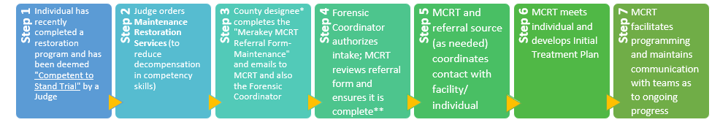
THE DETAILS: REFERRALS FOR THOSE “COMPETENT TO STAND TRIAL”
MCRT reviews referral form and ensures it is complete**
MCRT and referral source (as needed) coordinates contact with facility/ individual
Within 10 days, MCRT meets individual and develops an Initial Treatment Plan
MCRT facilitates programming and maintains communication with teams as to ongoing progress
* County designee will complete the “MCRT Referral Form- Maintenance” unless a previously specified point of contact is assigned.
** It is critical that a referral form is completed in its entirety- with the accompanying documentation, to allow MCRT to begin working as quickly and efficiently with the individual. MCRT may not begin the intake process until the Forensic Coordinator first authorizes the admission.
This process is amended as the program operates and as individual county needs arise.

Slide 20

THE DETAILS: SERVICE PLANNING
At the conclusion of the first session with the individual, MCRT staff will have completed an “Initial Service Plan.” This plan incorporates:
Strengths
Barriers
Educational attainment and implication on interventions
Legal history
Break down of CompKit Modules
Discharge criteria
The initial plan is active for up to 30 days
A “Comprehensive Service Plan” is then developed (same criteria as above and restoration progress, assessment scores) and will be reviewed every 30 days to make necessary updates and reflect on progress gained.

Slide 21

THE DETAILS: ASSESSMENT
To better serve the individuals and to monitor progress gained in the 3 domains of competency restoration (factual understanding, rational understanding, ability to assist in defense), MCRT incorporates the evidence-based assessment tool, FIT-R at intake and every 60 days thereafter.
This information assists with measures of competence over time, and tailors education based on needs shown.
MCRT DOES NOT DETERMINE COMPETENCY, this remains the job of the evaluator/judge

Slide 22

THE DETAILS: COLLABORATION
MCRT is designed to be highly collaborative
Staff Meetings Weekly
Interagency Meetings at regularly scheduled intervals Regularly scheduled supervisions
Case reviews
Monthly meeting with OMHSAS/MHA, 10 active service counties (court liaisons), and TSH, along with our Restoration Counselors and Peer

Slide 23
PROGRAM OUTCOMES Updated January 2024
69 Individuals were served
32 have both Felony and Misdemeanor Charges
71 different charges were represented
52 different diagnosis represented
36 individuals had an SUD diagnosis
43 individuals were diagnosed with a psychotic disorder
10 individuals were IDD (7 or 70% discharged successfully, 1 is still active with services, 2 or 20% discharged as unsuccessful)
Average number of days with MCRT: 217
35/41 cases have been discharged successfully (85% success rate)
4 individuals came into the program as non-restorable and 3 have been discharged successfully and 1 is still in active services (75% have been restored)

Slide 24
Statistics

Slide 25
Discharge Statistics: Restored and Unrestored

Slide 26






TO SUMMARIZE
Mental illness is everywhere; we’re all affected
We welcome any questions or feedback:
Lisa Sands MS CFI,
MCRT Program Director lisa.sands@merakey.org
Lauren Hickman MS CAADC CFI,
Director of Community-Based Programs lauren.hickman@merakey.org
John Eliyas MS
Executive Director
John.Eliyas@merakey.org
Thank you for your time and attention!
It is an individual’s Right to have a speedy and fair trial. To stand trial, there are 6 key domains that must be present, which would indicate competency
Competency evaluations are the most common forensic evaluation
Long wait times for evaluation and restoration are not only unjust, but extremely costly and can also lead to increased mental health deterioration and problem behaviors for staff
MCRT is a programmatic response to this which sees that individuals get quality restoration in the designated setting quickly and while alleviating some of the burden on declining hospital beds. Maintenance services encourage ongoing participation in education curriculum to reduce decompensation.
MCRT is a new and exciting program that looks to adapt based on each county’s unique needs and population

Slide 27

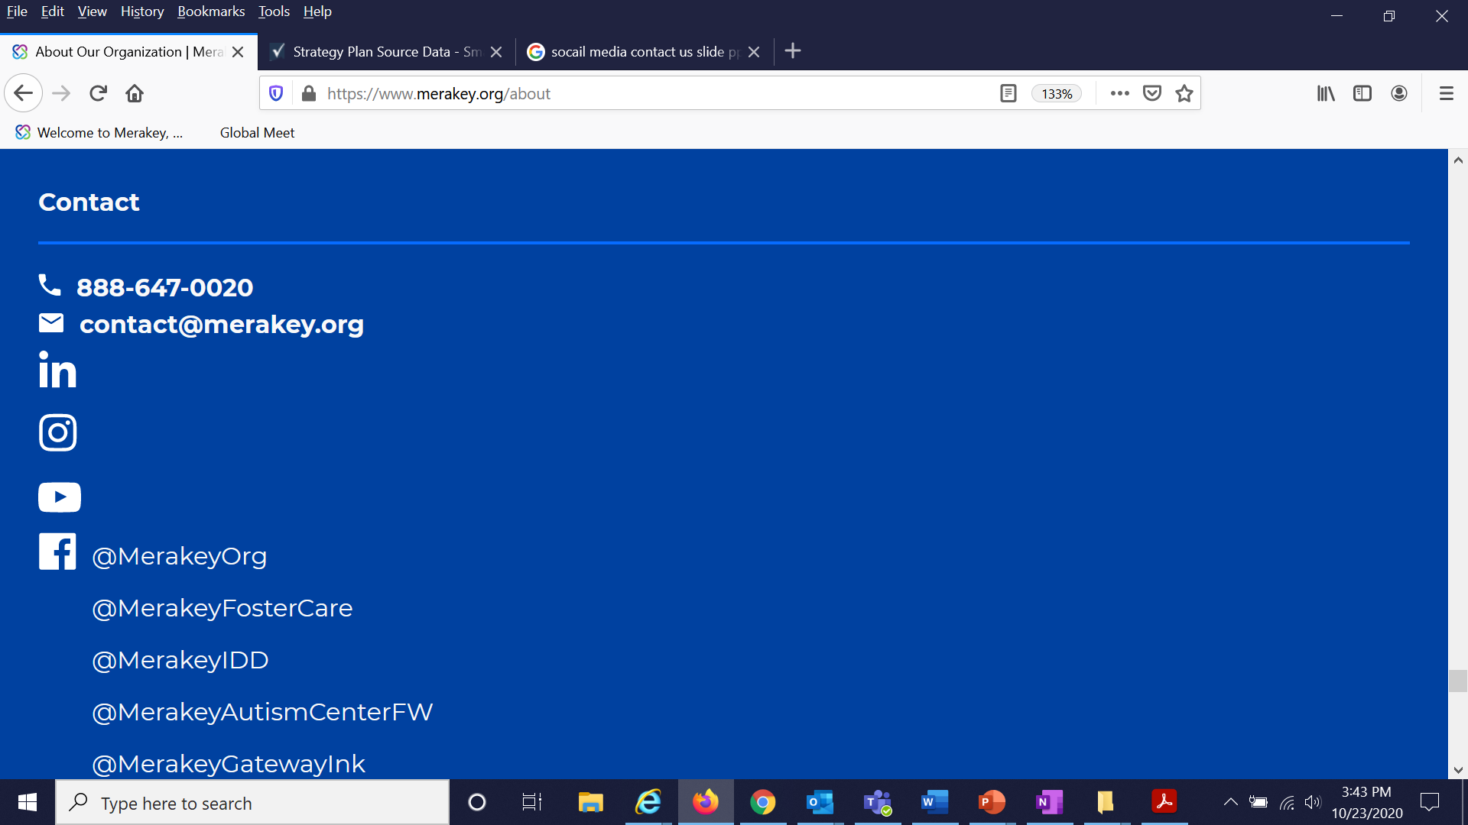
www.merakey.org
888-647-0020
MCRTreferrals@merakey.org
@merakey
@merakeyorg
@merakeyorg
@merakeyorg
https://online.fliphtml5.com/egvqq/yszn/#isNeat

