Slide 1

Creating Planes of Equity

Slide 2

Unprecedented Times
&
Challenges

Slide 3


Uncommon Heroes Doing Uncommon Work
Our Champions are fading
System Stakeholders underestimating their value
We wear the capes now
To serve other we must serve ourselves first
But we must be ready…….we must be well to for the journey

Slide 4
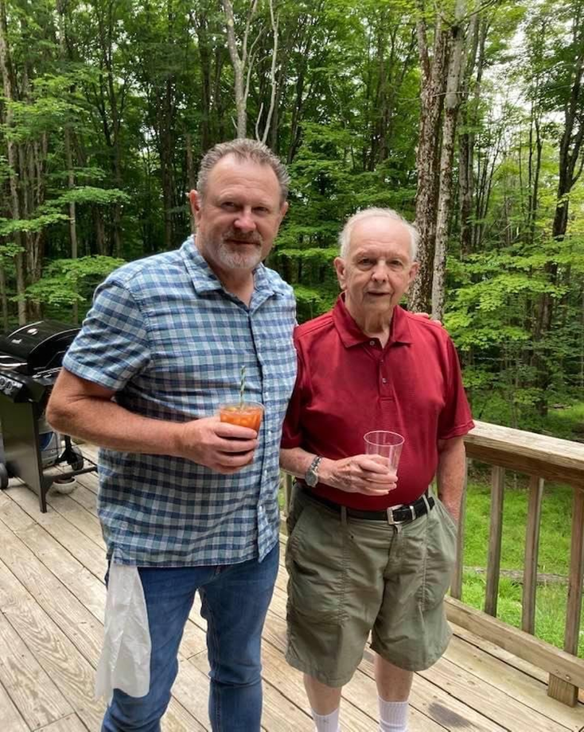
It only took 60 years…

Slide 5
What is wellness?
wellness
noun
well·​ness ˈwel-nəs
the quality or state of being in good health especially as an actively sought goal lifestyles that promote wellness

Slide 6


What does wellness look like?
Me vs. You vs. Anyone vs. Everyone
Amalgam of feelings, environment circumstances
Critical to functioning and understanding in your world
Intersects are Dimensional and Personal

Slide 7


Slide 8
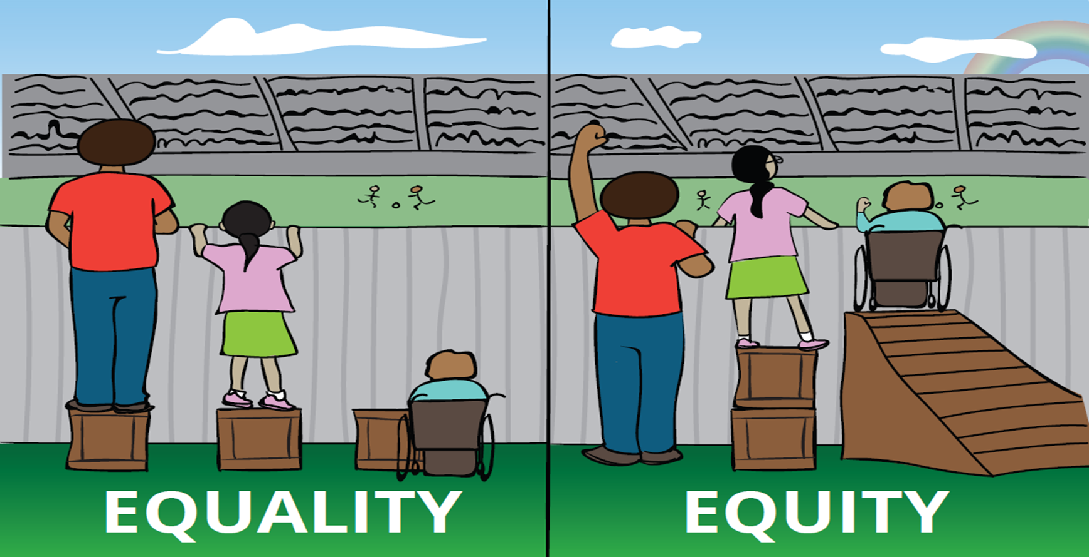
The Path to Equity

Slide 9
Barriers to Equity
The New Administration and the Federal uncertainties
Workforce changed as the pandemic unfolded as Professional and clinical staff wanted to work from home
Administrative Regulatory burden drive worker to private sector
Covid related funding going, going gone...
PA goofed on the Medicaid PHE unwinding Leaving thousands without coverage
Wage disparity drove staff out of the workforce Direct Care vs. Sheetz
PA Geography is a major influencer on access
Rural vs. Suburban vs. Urban does not always tell the full story
Access does not always equate to equity

Slide 10
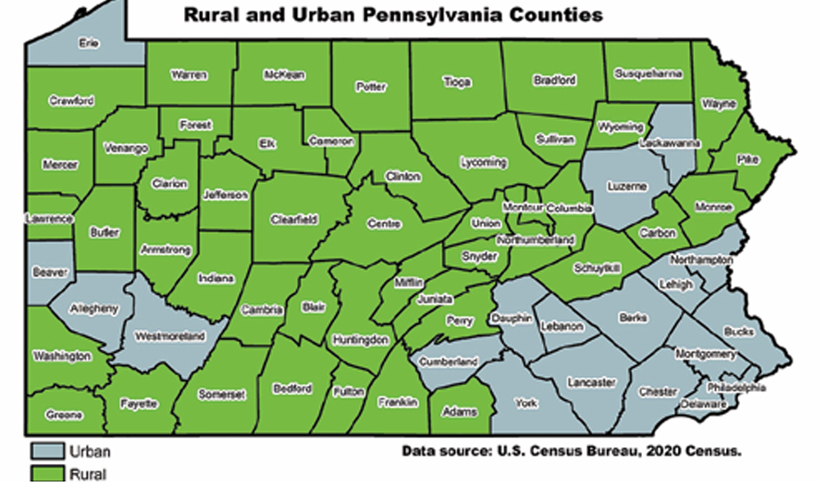
Pa Rural Health: A New Focus

Slide 11
Challenges for Rural Health
Poverty Rates on par with urban areas
Less Access to resources
Less economic stability
Educational Access and quality
Homelessness redefined and actualized
Nearly a million older Pennsylvanians live in rural communities
Workforce Shortages to behavioral health care professionals long before Covid
Substantially less access to care
All contribute to declining health outcomes and disparities
*
Pennsylvania Rural Health Association (PRHA) Pa Rural Health Plan 2025-2030

Slide 12
Rural Behavioral Health Implications
Stigma: Behavioral Health issues and counseling are not openly discussed in rural communities, preventing rural residents from knowing which services are readily available.
Access to Psychiatric Hospitals 5 Rural Facilities our of 35 across Pennsylvania
Licensed Mental Health Professionals 1/4 of the non rural counties and yet make up 25% of Commonwealth population.
In 2022, 44 of the 48 rural counties were classified as a “whole county shortage” territory for mental health professionals workforce.
Greater distances to travel continue to impact access
Psychiatrists and clinical psychologists by number are available to rural residents at half the rate available to urban residents.

Slide 13
Rural Behavioral Health: The Path Forward
Funding helps but significant focus on workforce, programming and access will require long term commitment.
Incentives need to be implemented to position professionals in rural counties. Increasing professional service reimbursement in the designated Pennsylvania Mental Health Professional Workforce Shortage Areas
The use of telehealth/ behavioral health application for mental health and substance abuse disorder, for rural Pennsylvania has increased access exponentially in reducing time and facility travel distance.
Reducing regulatory and administrative burden at the state level of OMHSAS creates less strain on working professional staff
The transformation of whole person care and the expansion of current programs that integrate physical and Behavioral Health care communities create :one stop shops”

Slide 14
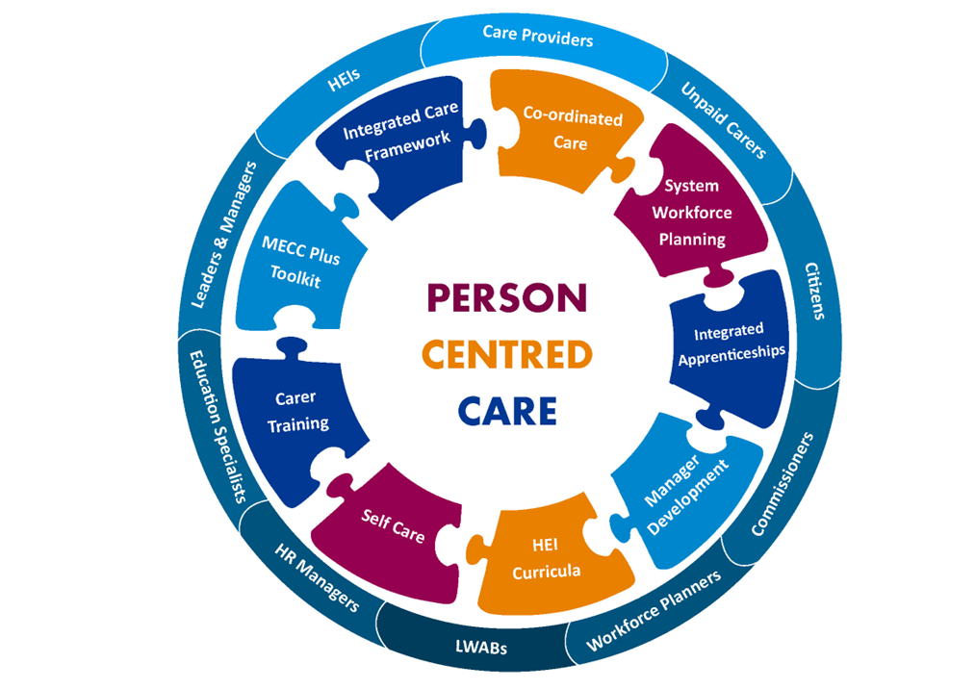
The Whole Picture
=
The Whole Person
The intersects of Physical Health and Behavioral Health
Comprehensive treatment plan to address the biological, psychological, and social needs of the patient
Investing in one is not enough
PA life expectancy has dropped from 78 to 76 from 2019 to 2021
Creates timely access to services
Federal and State Initiatives
  FQHC’s
  CCBHC
  ICWC (PA Specific)

Slide 15
Federal Rural Health Transformation Project
Initiative Funding
PA Plan
$50B over 5 years ($10B/year 2026-2030)
$5B split among 51 States annually
Second $5B allocated by approved State Project
Focus on, Workforce, Access, Innovative Care, Technology
Flexibility in funding and programming
Projected to bring $200M annually
PA Application Due 11/5/25
DHS Surveyed for recommendations up till 8/29/25
Includes capacity to expand integrated care programs ICWC, CCBHC
Blue Print from PA Rural Health Plan 2025-30

Slide 16
Unprecedented Times
&
Challenges

Slide 17
Pennsylvania BH Spend, Trends & Budget
2019 to 2024 $1.06b to$3.69b
Pa Ranks #2 in Population Served
Pa. Ranks #3 in total Spend $3.69b
Pa ranks #5 in Per capita Spending
Pa Ranks top 5 in spend per client
Pa one of most well resourced States for BH
PA Legislature Misses Budget Deadline again 14x in last 23 years
County MH Funding Set for $20m Needs $100m
$10m for Rural Hospitals
$600+ in BH Capitation Medicaid HealthChoices
$20m for Early Intervention Services
Accountable Funding for Reimagined School Based MH -$100m

Slide 18
Hold On Tight
Federal Medicaid
PA Impacts
Cutting 1 trillion over 10 years
Medicaid Expansion Population Only
Eligibility Determination every 6 months 2027
Work Requirements – 80 hours per month
Provider Tax Reductions
More Uncompensated Care
$ Annually for PA
700,000 Pennsylvanians
$300, 000 could lose Medicaid
IDD ,MH , SUD Population
Cost to implement programs $50m+ /yr.
Less funding for rural hospitals

Slide 19
Ray of Hope
Despite the Challenges we are making gains
More individuals, children and families serviced in PA than ever before
Funding for Human Services and Behavioral Health continues to grow
  School Based, County MH, Early Intervention Rural Health , Integrated Care
Telehealth has changed the delivery landscape and it is expanding
Better understanding in the PA General Assembly
Legislation aimed at workforce initiatives
The State is trying…

Slide 20

We Must Be Better Together
Continued to understand the population needs through engagement
Begin to build the workforce infrastructure earlier in the process
Build network capacity across all regions populations
Advocate for sustainable and transparent funding models
Reform regulations that promote flexibility and reduction in administrative burden
Leverage technology to expand access
End useless commissions and committees and invest in viable strategic efforts to rebuilding the Pa behavioral health system
Legislative awareness and accountability to ensure a future for the most vulnerable Pennsylvanians

Slide 21
Unfurl Your Capes
We are better together than divided
We have to circle the wagons as individual agencies and a community
Empower and share the weigh of advocacy ……for every one leader
Advocacy is no longer just for lobbyist
Find your tribe we are out there just not connected yet
We take care of ourselves first so we can take care of those we serve
Persistence wins the day..

Slide 22

Questions & Contact
Jim Sharp RCPA
jsharp@paproviders.org
717-525-4097
Emma Sharp
Esharp@paproviders.org
570-441-0164

Slide 23
Thank you!

Slide 24
Resources
For Immediate Help: Call 988 County-specific crisis lines.
County Service Care Provider SearchSearch for drug and alcohol treatment providers
County MH Services https://www.mhdspa.org/local-contacts
Pennsylvania Behavioral HealthChoices Program
DHS Human Services Provider DirectorySearch for mental health treatment providers
Mental Health Advanced Directives Information
(Pennsylvania Network of CareA web resource that provides information and tools, such as: Information and service directories for every Pennsylvania county

